Slide 1
The leading question: What is the benefit to having a two-layer CPG?
There is no proven evidence shows this two-layer CPG structure exists, nor does we know how those layers receive feedbacks.
It is useful to maneuver or maintain the gait. (In previous published paper, this hypothesized two-layer CPG enables flexibility at the individual step level while still maintaining an overall timing.)
Goal for current studies:
To better understanding how the two-layer CPG works and what sets of parameters will provide us with the most effective behavior, such that it can generating outputs base on pure rhythm generator signal or pure pattern formation signal, or a mixture of both.

Slide 2
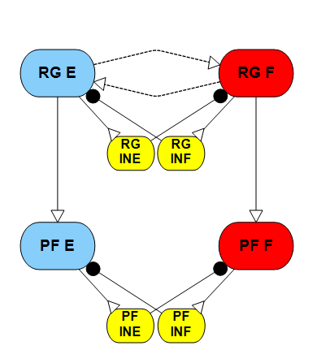
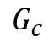
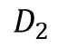
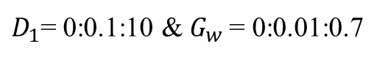
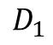
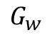
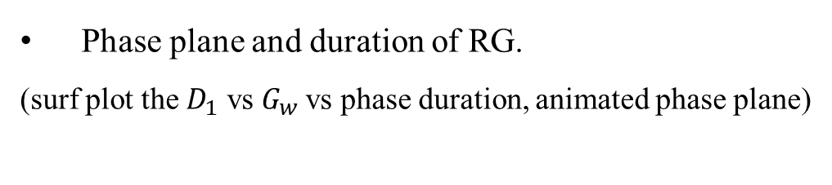
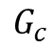
Recap:
$$D_{1}$$
Phase plane and duration of RG.
(surf plot the $D_{1}$ vs $G_{w}$vs phase duration, animated phase plane)
$$G_{w}$$
$$G_{c}$$
$$G_{c}$$
$$D_{2}$$
$D_{1}$= 0:0.1:10 &$G_{w}$ = 0:0.01:0.7

Slide 3
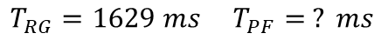
Phase duration under different parameters:
Base on previous study, we pick descending command to rhythm generator as constant drive 2 nA, the weak conductance between oscillator set to 0.1 uS. Here are 3 typical examples of CPG outputs base on different parameters.
$$T_{RG}=1629ms T_{PF}=1013ms$$
$$T_{RG}=1629 ms T_{PF}=1629 ms$$
$$T_{RG}=1629 ms T_{PF}= ? ms$$
Pure PF signal
Pure RG signal
Mixture
Question: how to define the phase duration?
(Like in mixture case, it repeat every 1629 ms, but generates peaks around every 335 ms)

Slide 4
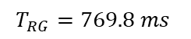
How descending command to PF changes the CPG?
With descending drive to the rhythm generator set as constant drive 3 nA, the weak conductance between oscillator set to 0.1 uS and conductance between RG and PF equals 0.1 uS. Sweep the pattern formation layer descending drive to investigate how this drive alone will influence the CPG output.
Dashed black line: phase duration of RG
Red line: phase duration of PF (the output)
On the descending curve, phase duration leans towards the PF descending, but the shape is affected by RG rhythm.
When PF descending drive large than 9 nA , the output tends to mixture signal.
$$T_{RG}=769.8 ms$$
On this set of parameters: when descending drive to PF is small, the out put follow the signal of RG, once the drive reach 5 nA , the drive take over the role of generating output until it reach 9 nA.

Slide 5
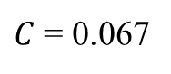
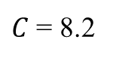
How conductance between PF and RG influence the CPG?
With descending drive to the rhythm generator set as constant drive 3 nA, the weak conductance between oscillator set to 0.1 uS and descending drive to the PF equals 5 nA. Sweep the conductance between RG and PF to investigate how this connection alone will influence the CPG output.
$C$ = 0.067
$C$ = 8.2
We have studied this part last year, the results are when conductance between 0.067 to 8.2, the signal from RG can be transmitted to PF without losing shape.

Slide 6
When rhythm is set, how can D2 and C combined to influence the CPG?
With descending drive to the rhythm generator set as constant drive 3 nA, the weak conductance between oscillator set to 0.1 uS. Sweep the pattern formation layer descending drive and conductance between RG and PF to investigate how CPG output can be changed by other parameters when general rhythm is determined.
Conductance (uS)
Descending drive (nA)
As the result shows, most of the regions (CPG output phase duration) follows the signal of rhythm generator, which equals 769.8 ms . The only exception is when conductance is lower than 0.2.

Slide 7
When C is below 0.2:
Conductance (uS)
Descending drive (nA)
Most of the regions (CPG output phase duration) still follows the signal of rhythm generator, which equals 769.8 ms . The dent part follows what we observed previously: the PF drives take over the CPG output. The dark blue part is means the CPG did not receive enough stimulus to oscillate. The peak part stands very slow oscillation, which is not the behavior we need.

Slide 8
How the added RG changes the CPG results?
When the PF already oscillating with a constant drive of 4 nA, sweep the rhythm generator drive (the weak conductance between RG oscillator set as 0.1 uS) with different conductance between RG and PF to investigate how this added RG layer will affect the output of CPG. Start with few examples.
The RG starts to stable oscillating around 2 nA . When the connection between RG and PF is weak, the CPG outputs gets affected by the RG signal, but PF signal still take charge. When the connection is strong, the RG signal totally take over the CPG output. While the conductance equals 0.1 uS , interesting things happens. The CPG output getting affected by the RG signals (might treats as perturbation as the RG is not stable oscillating) before RG stable oscillating, then strictly follow RG signal till certain point.

Slide 9
D2 = 4 nA; sweep D1 & C:
Conductance (uS)
Descending drive (nA)
When the conductance between RG and PF is larger than 1 (or as we studied previously larger than 0.067), the resulting CPG output is the same, which means RG takes over the role of generating CPG output.

Slide 10
The phase duration difference between RG and PF:
Conductance (uS)
Descending drive (nA)
As the CPG output phase duration plot is not straight forward, the difference between RG and PF duration helps us understand what is going on. The plateau area means there is no difference between the RG duration and CPG outputs, the obvious difference happens when conductance less than 0.2.

Slide 11
When C is below 0.2:
Conductance (uS)
Descending drive (nA)
As showed in the example case, when conductance between RG and PF getting larger, the output phase duration is more affected by the RG signal. One interesting finding is, when RG drive is larger than 8, the CPG output when back to PF oscillating patterns.

Slide 12
The phase duration difference between RG and PF:
Conductance (uS)
Descending drive (nA)

Slide 13
How the drives cooperating produce the CPG results?
Given determined conductance between RG and PF, sweep the rhythm generator and pattern formation drive. what is the performance of the CPG?
The rhythm generator performance is only determined by the descending drive – D1 (also the weak conductance between the oscillator ).
So, we investigate the CPG performance with 3 typical conductance: C = 0.01; C = 0.1; C = 1.
The most obvious one is when C = 1, RG will take the lead.
Phase duration difference
D1
D1
D2
D2

Slide 14
When C = 0.1:
CPG output phase duration
D1
D2
Phase duration difference
D1
D2

Slide 15
When C = 0.01:
CPG output phase duration
D1
D2
Phase duration difference
D1
D2

Slide 16
Conclusion:
The conductance between RG and PF plays an important role in determine the behavior of CPG output:
In all the cases, when C is larger enough, the RG signal will lead the CPG output. However, as C gets larger, the phase duration will not change. Thus, C = 1 is a good baseline for CPGs that wants to stick to the general rhythm, like the hip joint.
For very small value C, like C = 0.01. The CPG output is tends to follow it’s own will with little influence from the general walking rhythm. This set of connectivity can be used by joints which needs to quick react to environment changes or have high Maneuverability like the toe (finger) or ankle if needed.
For the knee and ankle joint, we can choose the conductance base on the behavior we want. If we want to follow the general walking rhythm but also want to compensate small perturbation on the local level, we can choose C = 0. 1 for the knee joint as example. Or C = 0.03 for a soft ankle joint.

Slide 17
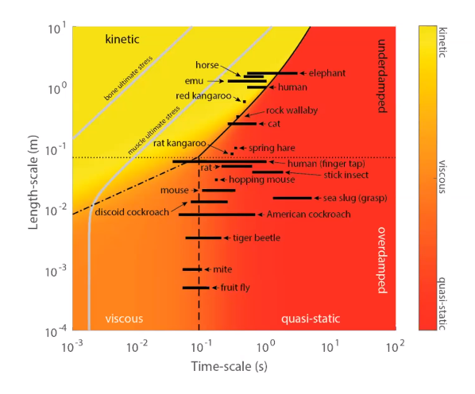
Thoughts:
Does this two-layer CPG can be applied to all legged animals?
Two legs
Four legs
Six legs
Human
Dog or Rat
Insects
High C value
Mixture
Low C value
Get plots base on scale and phase duration, color code with different C value similar to the figure on the right?

